Slide 1
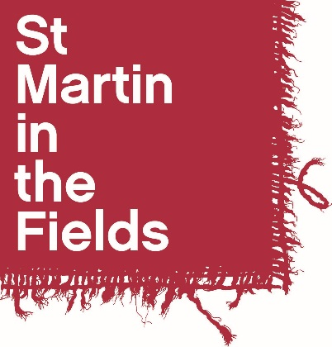
Inspired to Follow:
Art and the Bible Story
a resource created by
St Martin-in-the-Fields
in association with The National Gallery

Slide 2
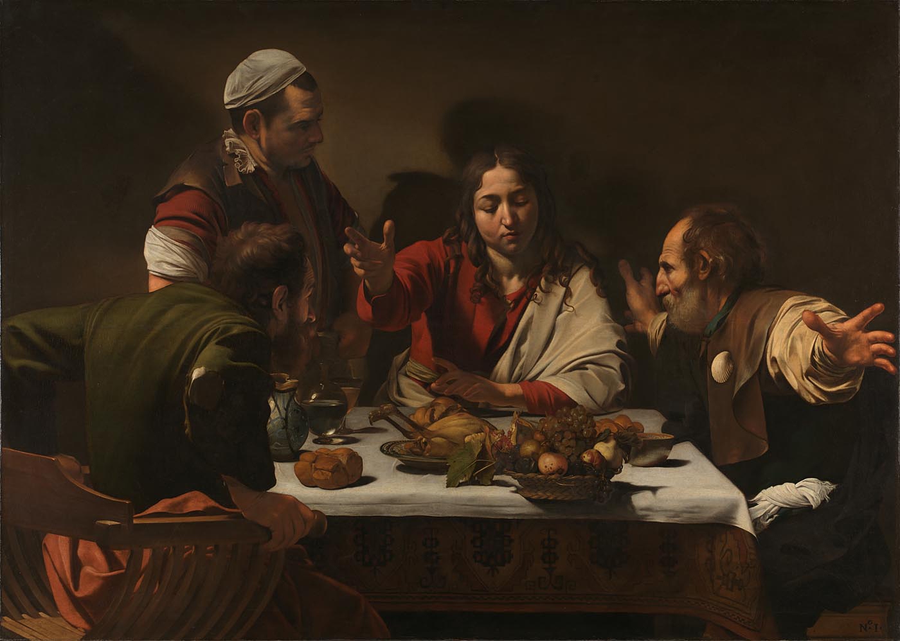
Michelangelo Merisi da Caravaggio, The Supper at Emmaus, 1601 © The National Gallery, London.
Presented by the Hon. George Vernon, 1839

Slide 3
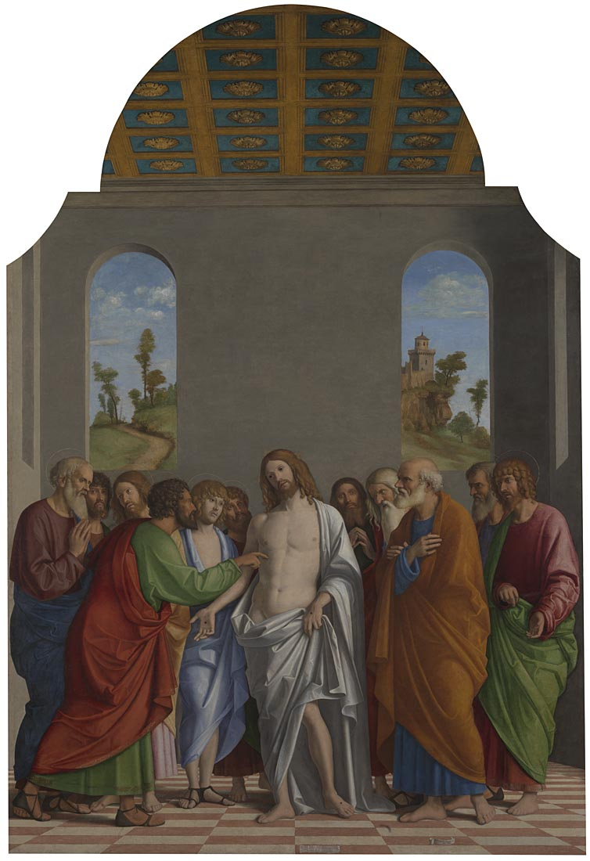
Giovanni Battista Cima
da Conegliano,
The Incredulity of Saint Thomas, about 1502-4
© The National Gallery, London. Bought, 1870

Slide 4
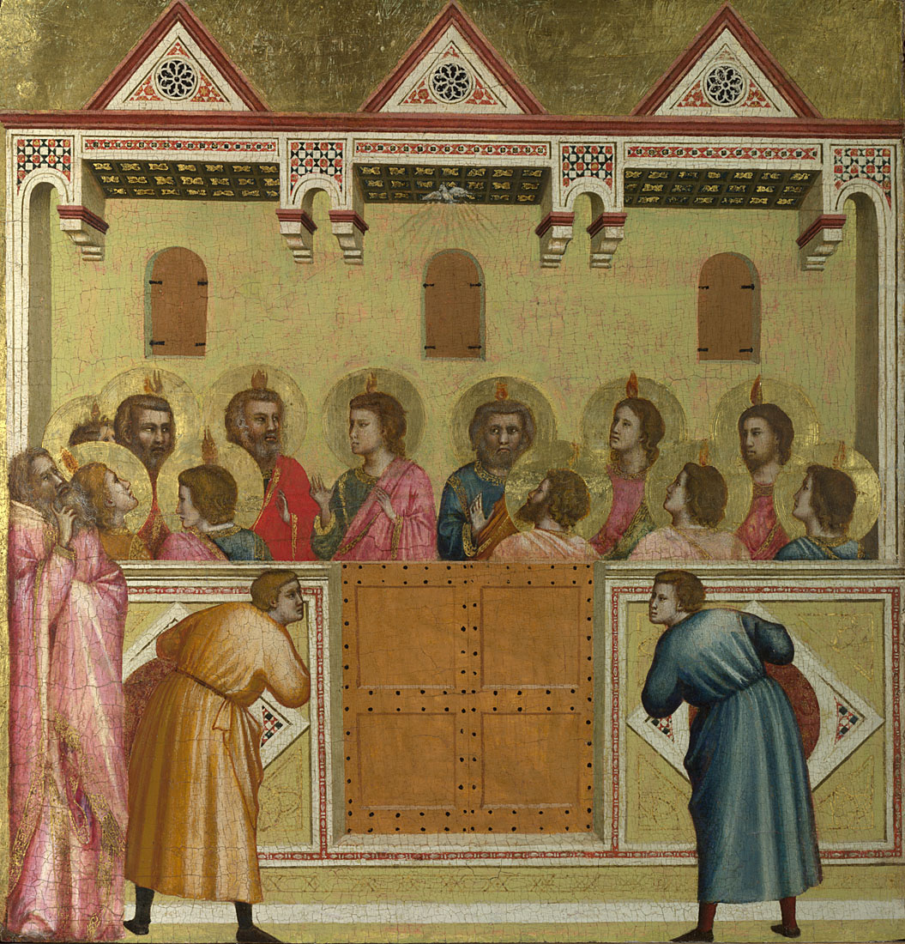
Giotto and Workshop, Pentecost, probably about 1310-18 © The National Gallery, London. Bequeathed by Geraldine Emily Coningham in memory of her husband, Major Henry Coningham, and of Mrs Coningham of Brighton, 1942

Slide 5
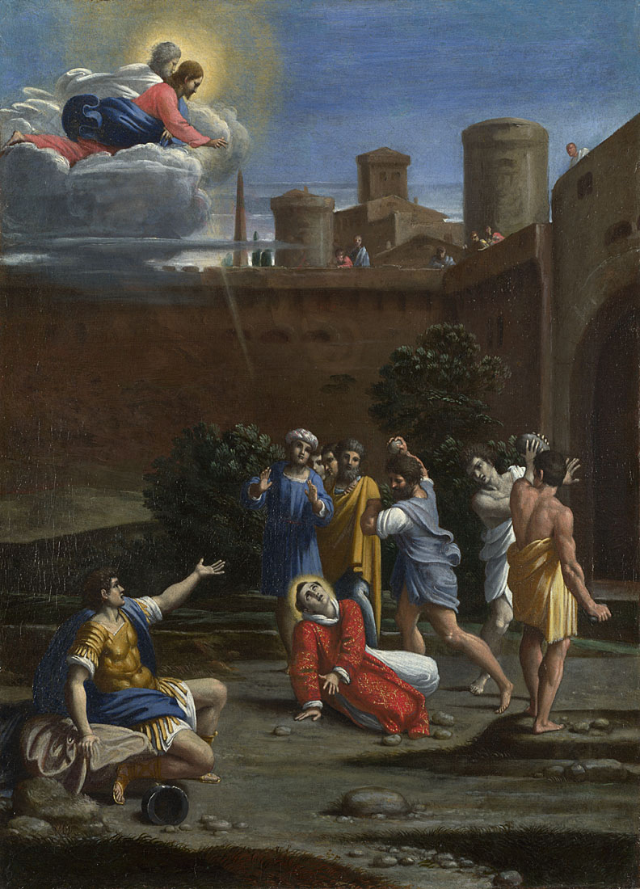
Possibly by Antonio Carracci,
The Martyrdom of Saint Stephen, about 1610
© The National Gallery, London. Holwell Carr Bequest, 1831

Slide 6
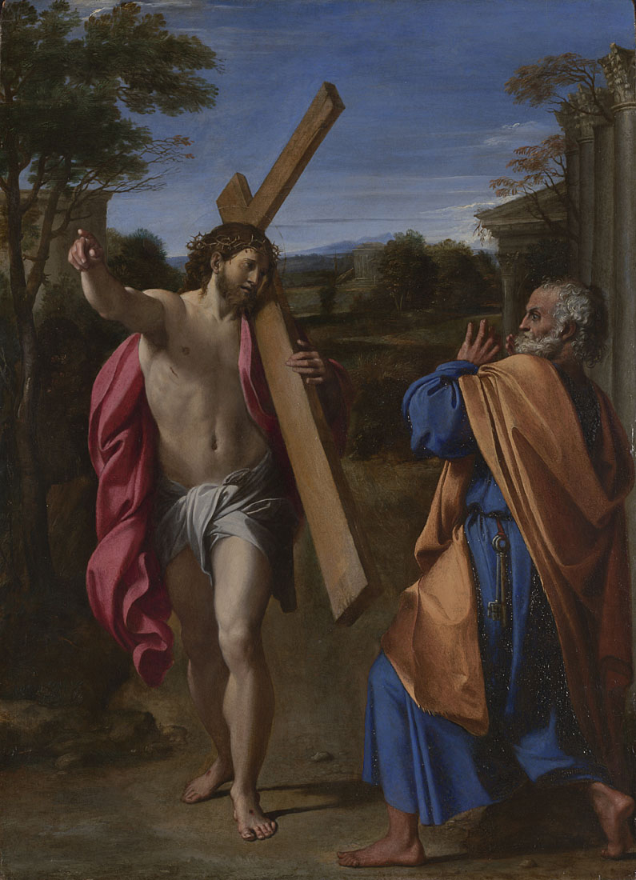
Annibale Carracci, Christ appearing to Saint Peter on the Appian Way, 1601-2
© The National Gallery, London. Bought, 1826

Slide 7
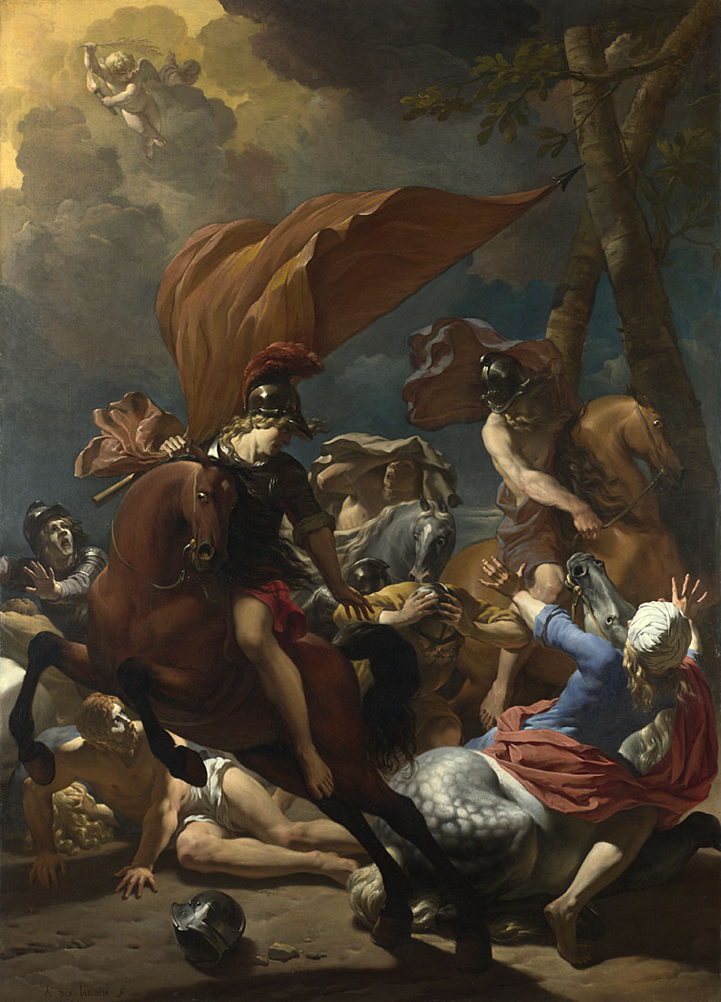
Karel Dujardin,
The Conversion of Saint Paul, 1662 © The National Gallery, London. Presented by Mrs Violet Van der Elst, 1959

Slide 8
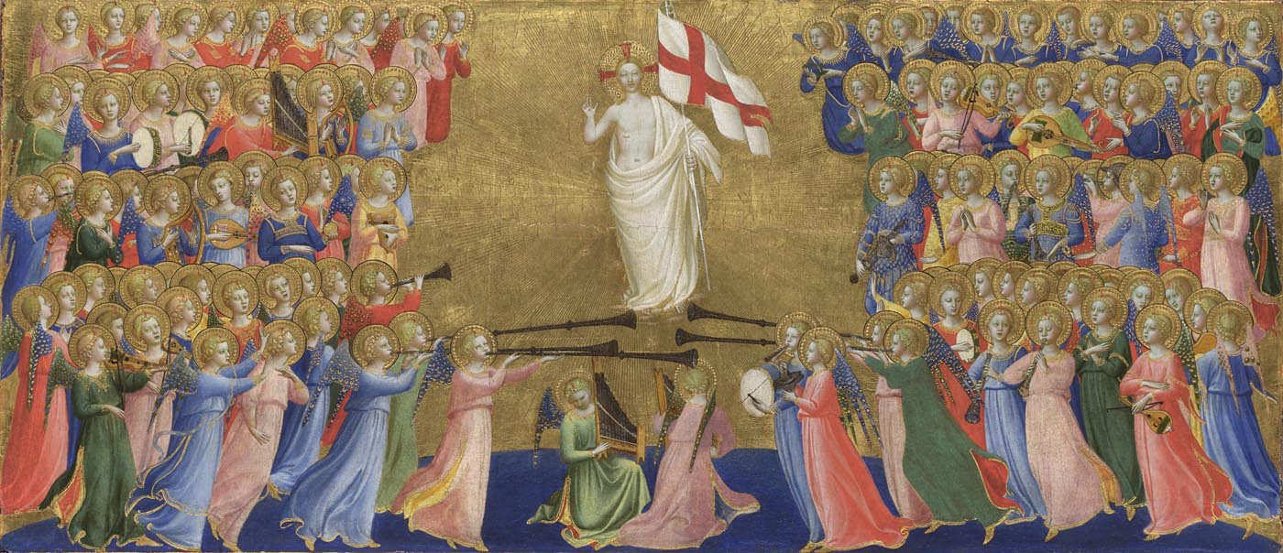
Probably by Fra Angelico, Christ Glorified in the Court of Heaven; central predella panel, about 1423-4
© The National Gallery, London. Bought, 1860

