Slide 1
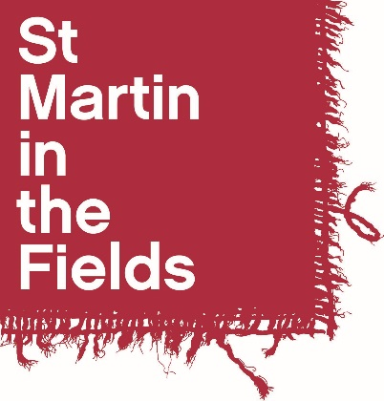
Inspired to Follow:
Art and the Bible Story
a resource created by
St Martin-in-the-Fields
in association with The National Gallery

Slide 2
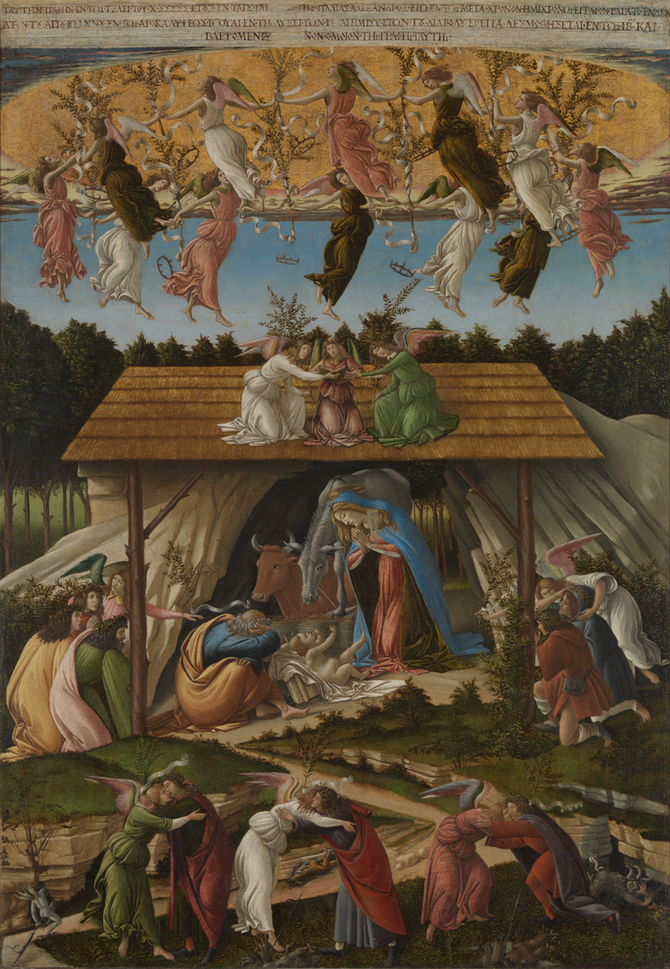
Sandro Botticelli,
‘Mystic Nativity’, 1500
© The National Gallery, London. Bought, 1878

Slide 3
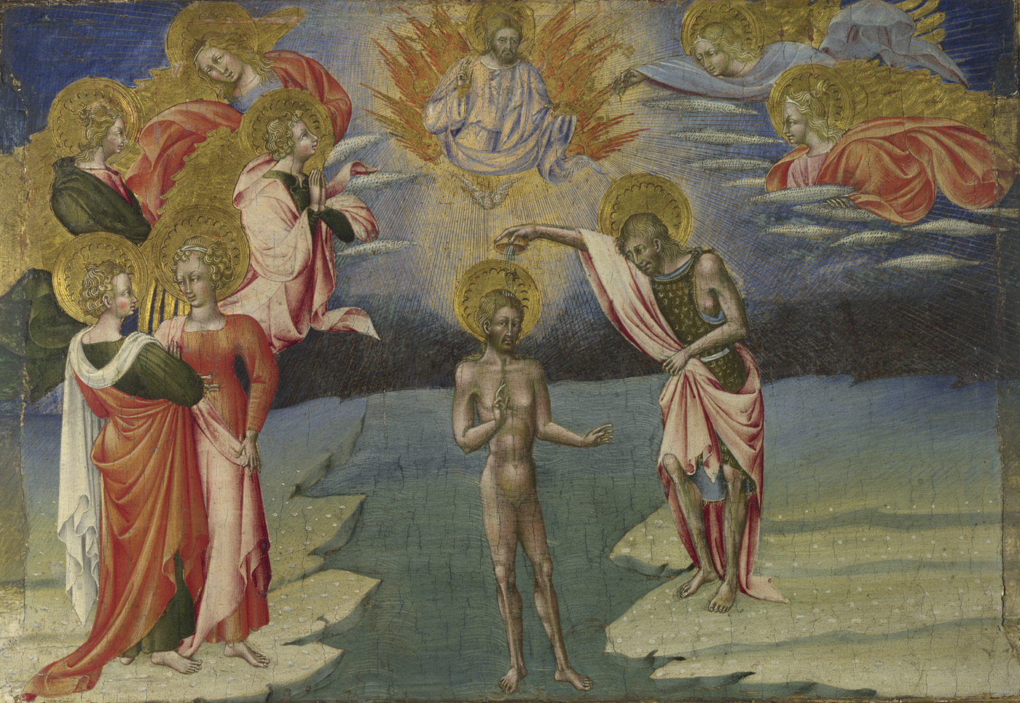
Giovanni di Paolo, The Baptism of Christ; predella panel, 1454 © The National Gallery, London.
Bought with a contribution from The Art Fund, 1944

Slide 4
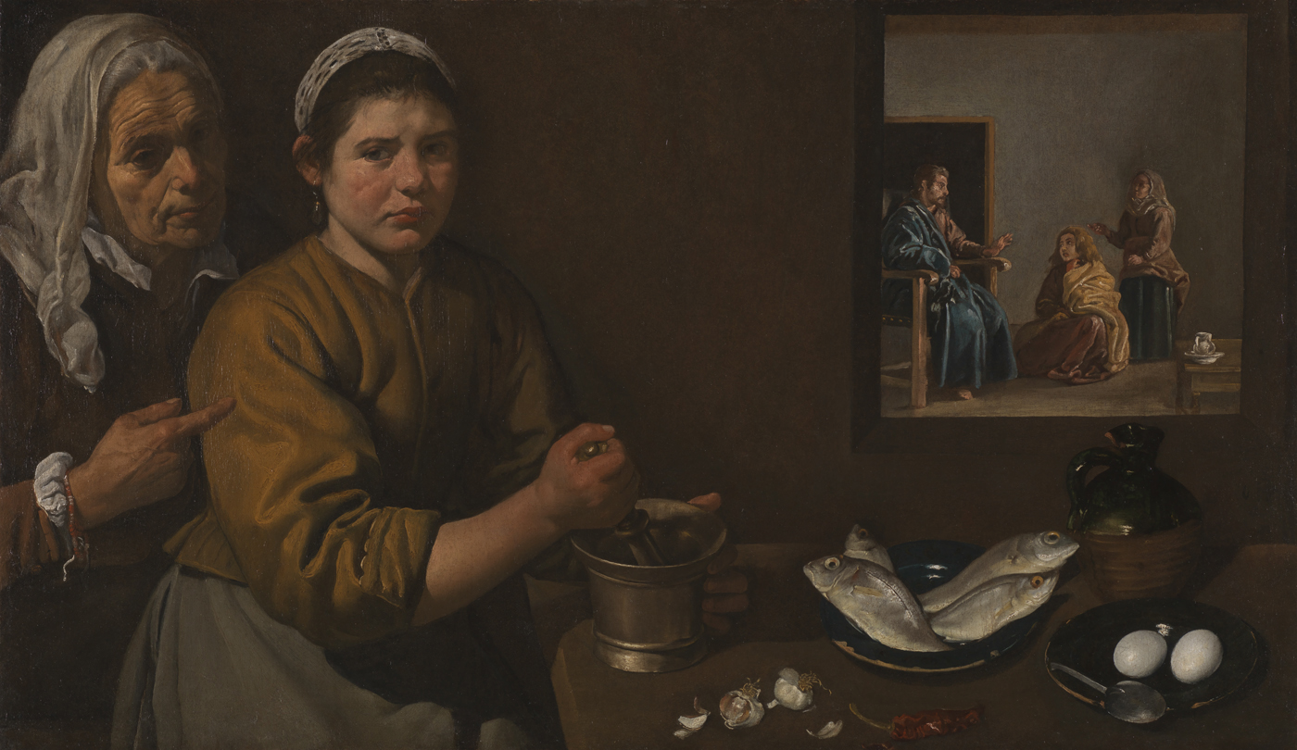
Diego Velázquez, Christ in the House of Martha and Mary, probably 1618
© The National Gallery, London. Bequeathed by Sir William H. Gregory, 1892

Slide 5
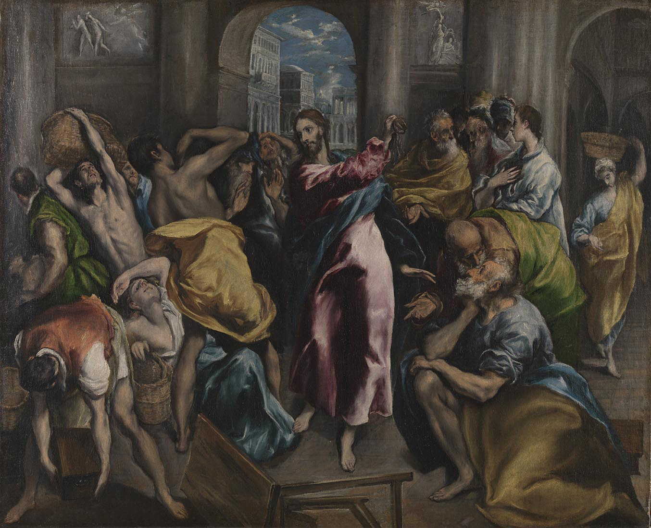
El Greco, Christ driving the Traders from the Temple, about 1600
© The National Gallery, London. Presented by Sir J.C. Robinson, 1895

Slide 6
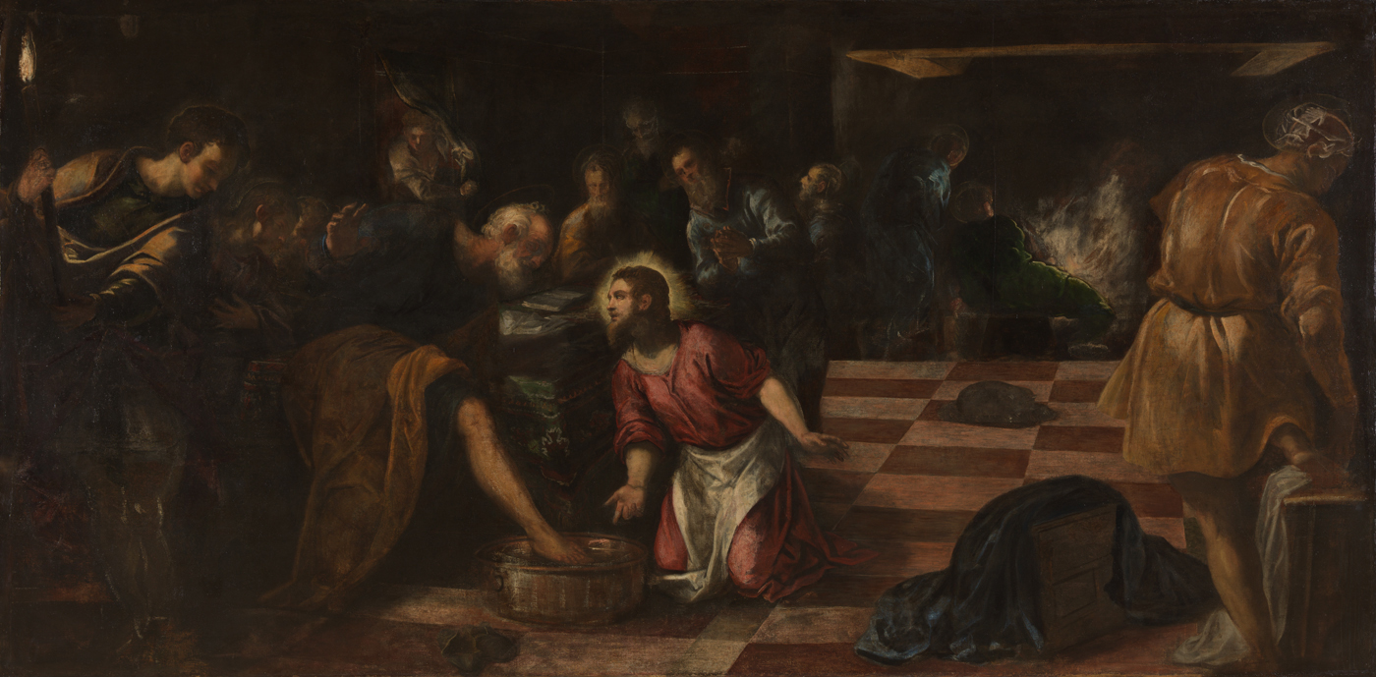
Jacopo Tintoretto, Christ washing the Feet of the Disciples, about 1575-80
© The National Gallery, London. Bought, 1882

Slide 7
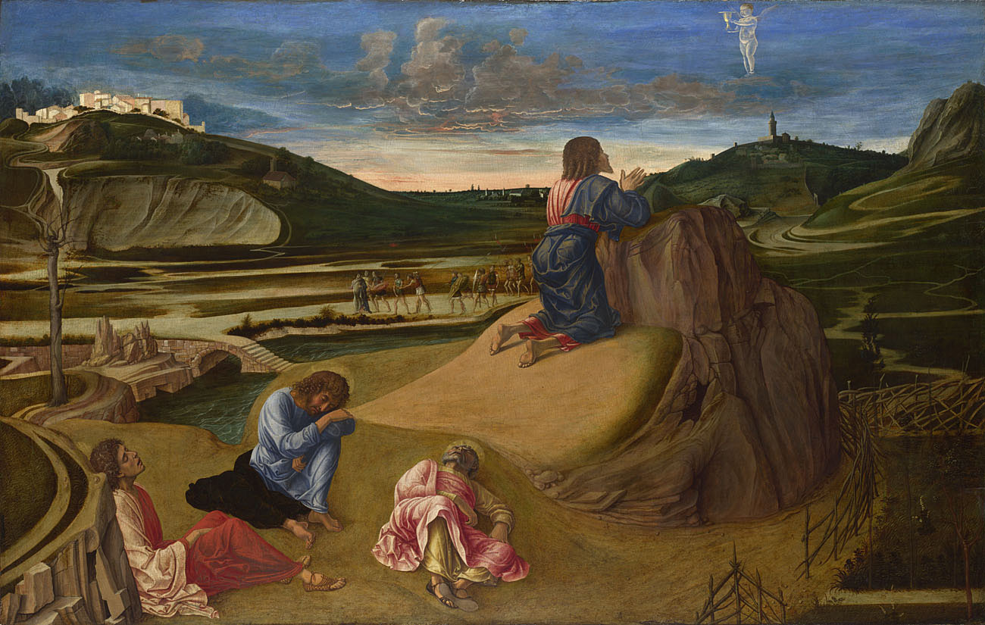
Giovanni Bellini, The Agony in the Garden, about 1465 © The National Gallery, London. Bought, 1863

Slide 8
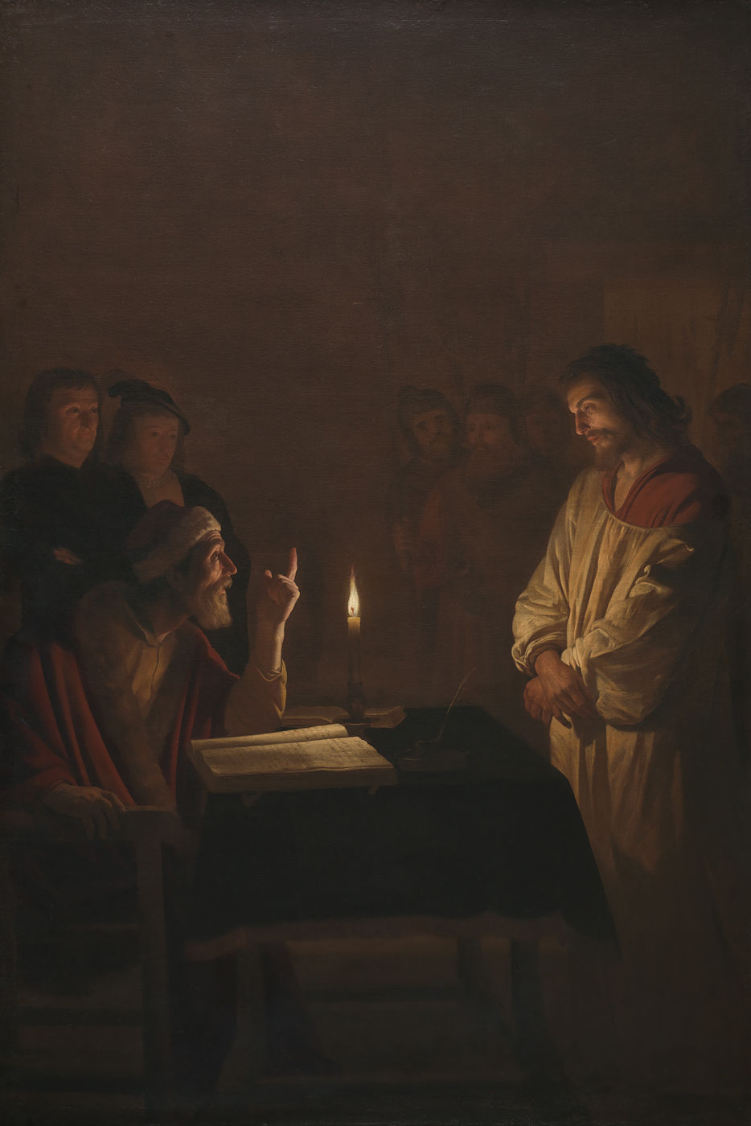
Gerrit van Honthorst,
Christ before the High Priest, about 1617
© The National Gallery, London. Bought, 1922

Slide 9
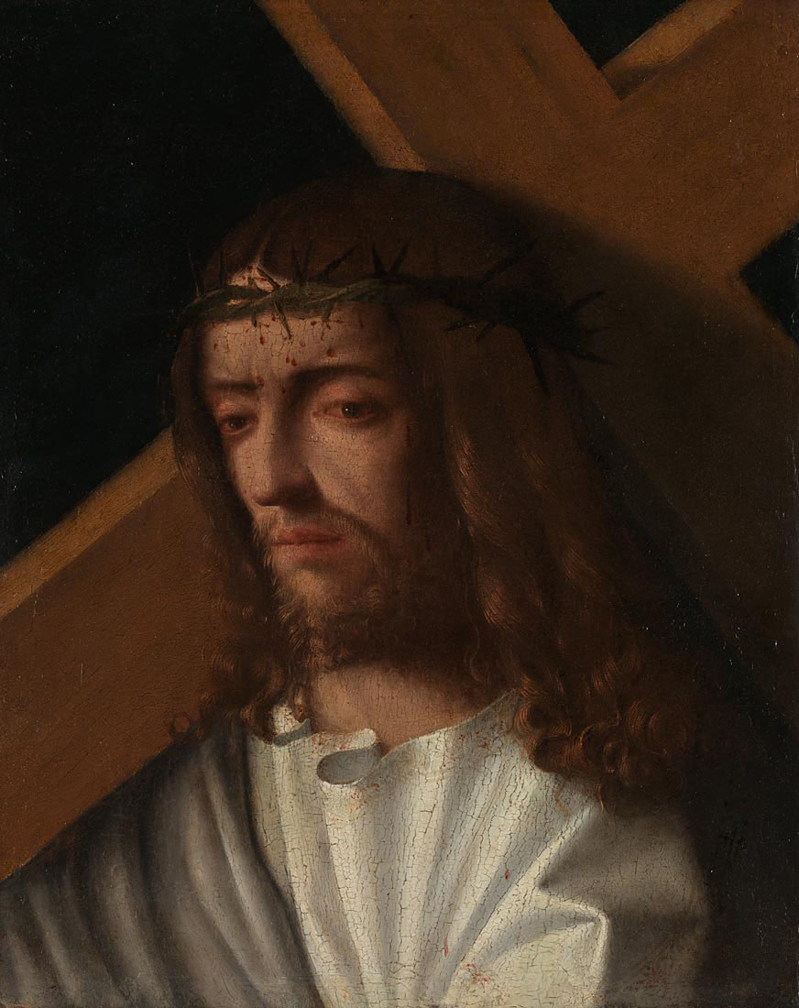
Italian, Venetian,
Christ carrying the Cross, about 1500
© The National Gallery, London. Presented by Angus Neill, 2015

