Slide 1

Inspired to Follow:
Art and the Bible Story
a resource created by
St Martin-in-the-Fields
in association with The National Gallery

Slide 2
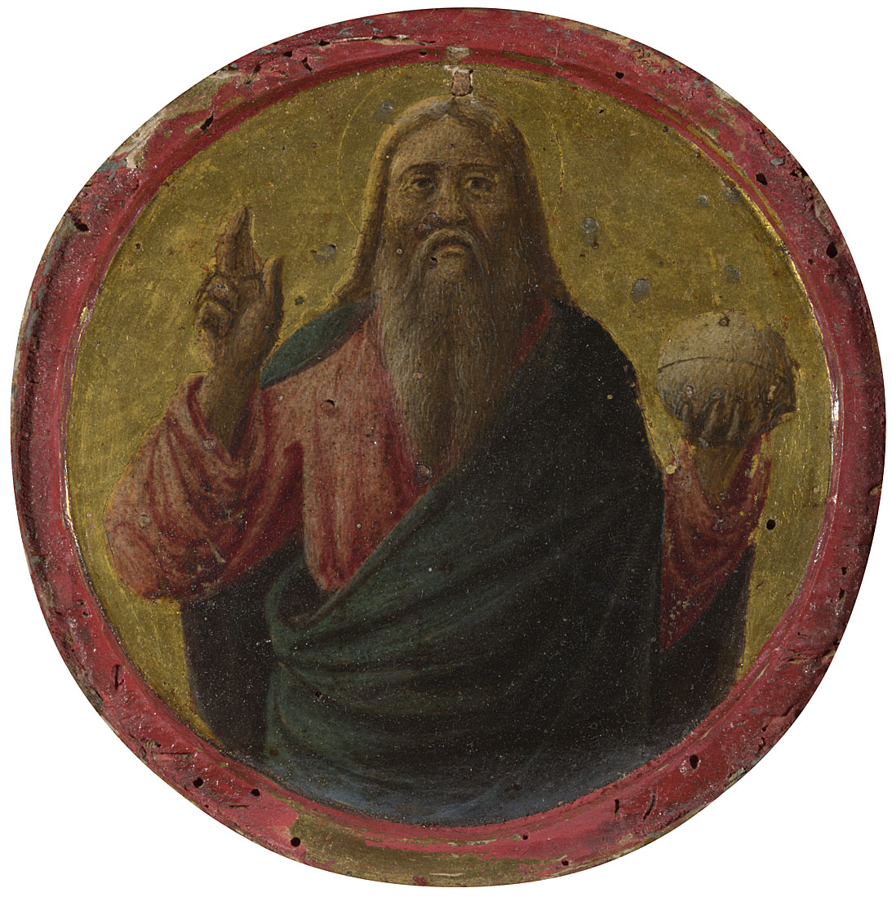
Italian, Florentine, God the Father, about 1430-40 © The National Gallery, London.
Presented by Charles Ricketts and Charles Haslewood Shannon through The Art Fund, 1922

Slide 3
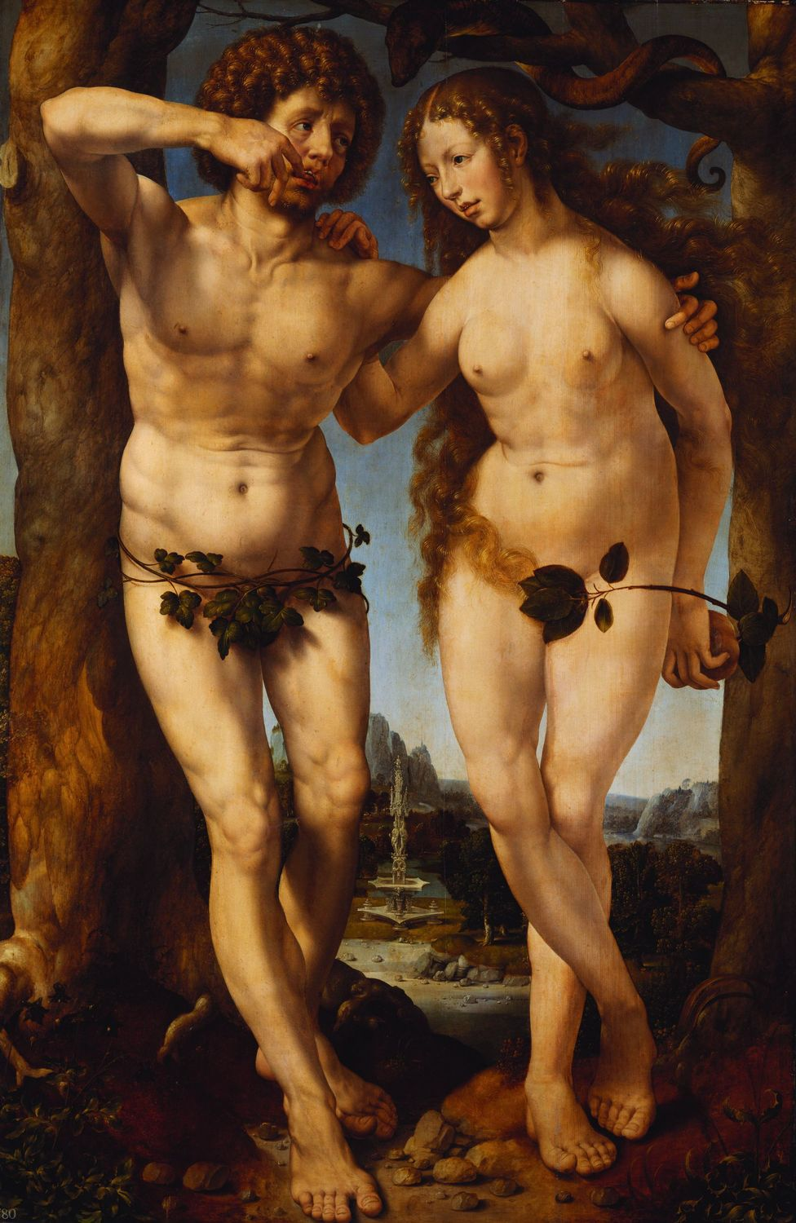
Jan Gossaert,
Adam and Eve, about 1520,
The National Gallery, London, on loan from The Royal Collection Trust
© Her Majesty Queen
Elizabeth II 2017

Slide 4
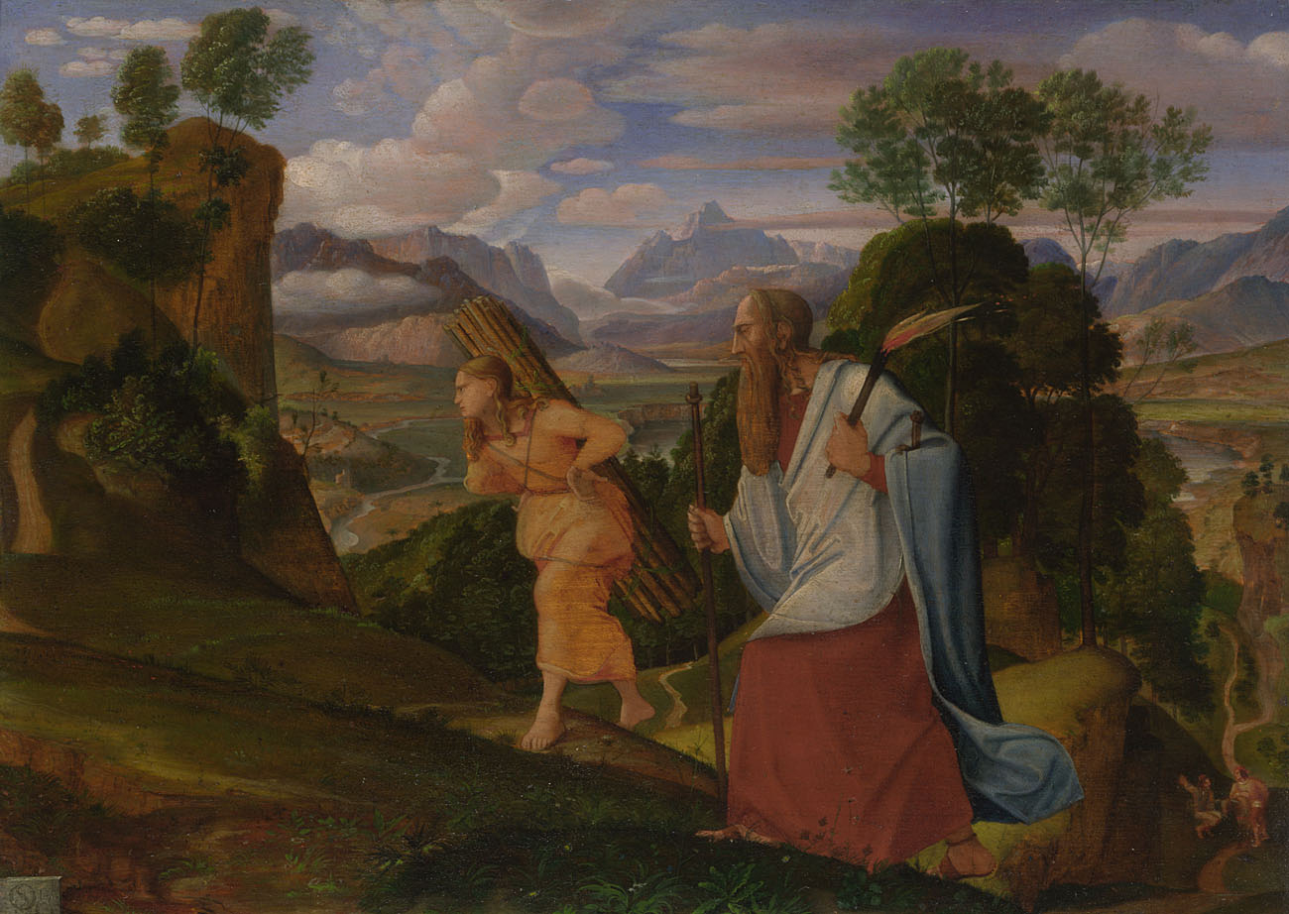
Johann Heinrich Ferdinand Olivier, Abraham and Isaac, 1817 © The National Gallery, London.
Presented by Bruno Meissner, 1992

Slide 5
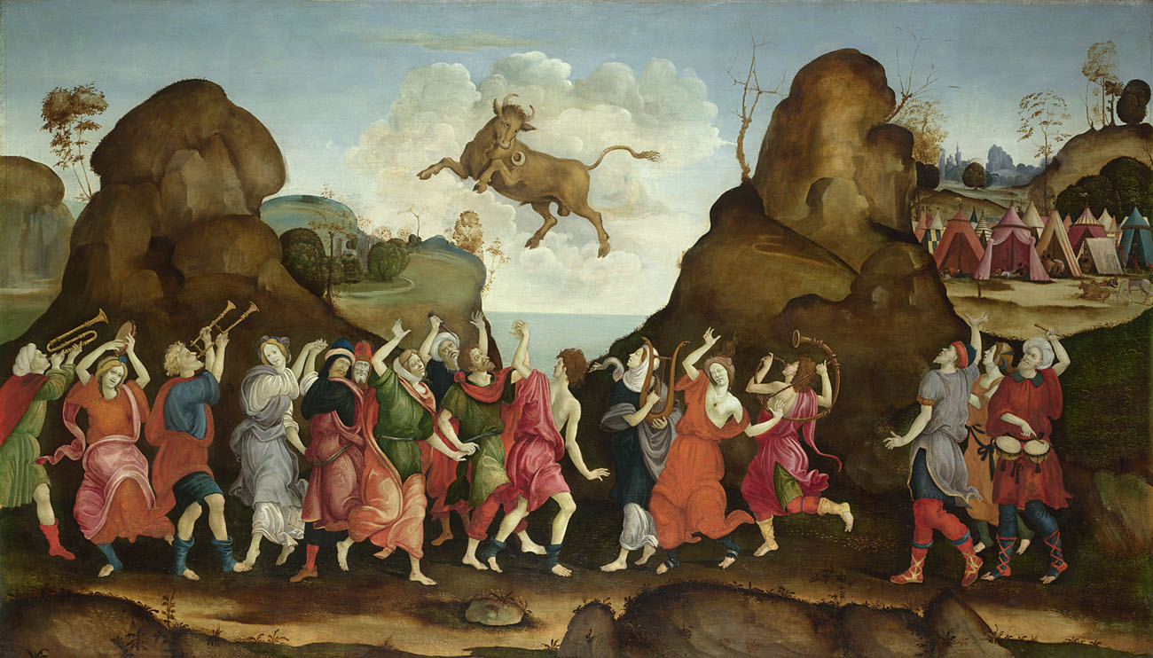
Follower of Filippino Lippi, The Worship of the Egyptian Bull God, Apis, about 1500 © The National Gallery, London.
Bequeathed by Sir Henry Bernhard Samuelson, Bt, in memory of his father, 1937

Slide 6
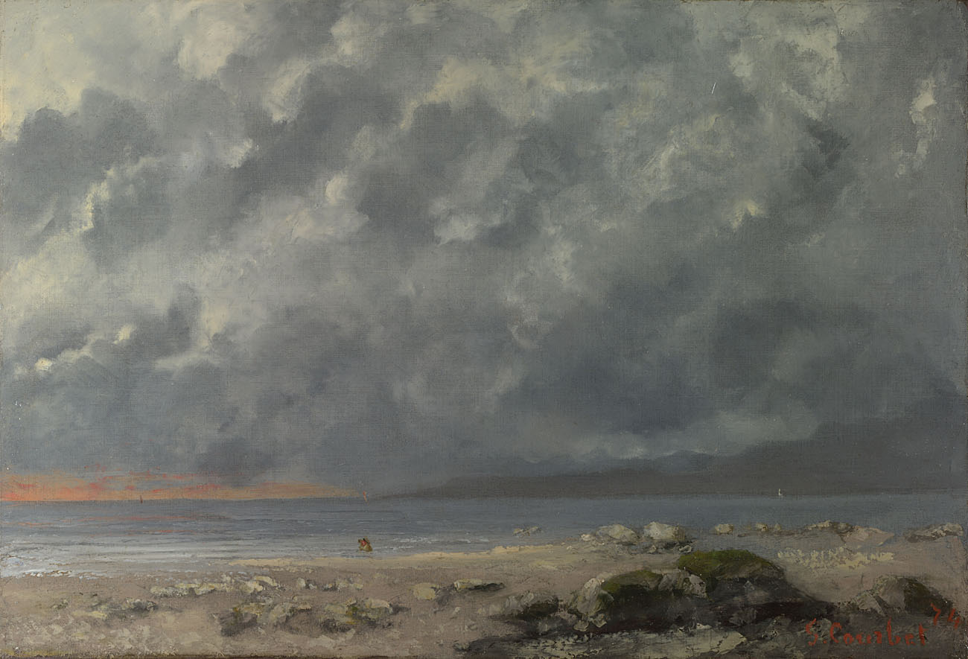
Gustave Courbet, Beach Scene, 1874 © The National Gallery, London. Bequeathed by Sir Robert Hart, Bt, 1971

Slide 7
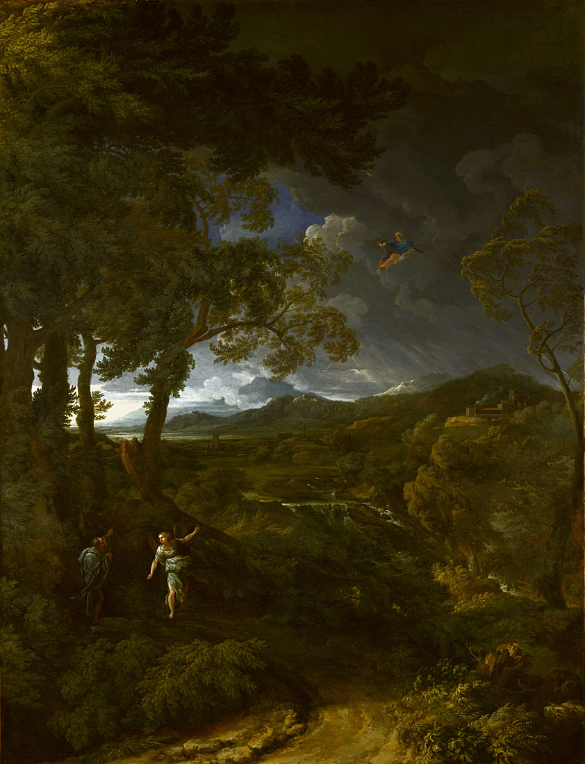
Gaspard Dughet, Landscape with Elijah and the Angel, about 1663 © The National Gallery, London. Bought, 1884

Slide 8
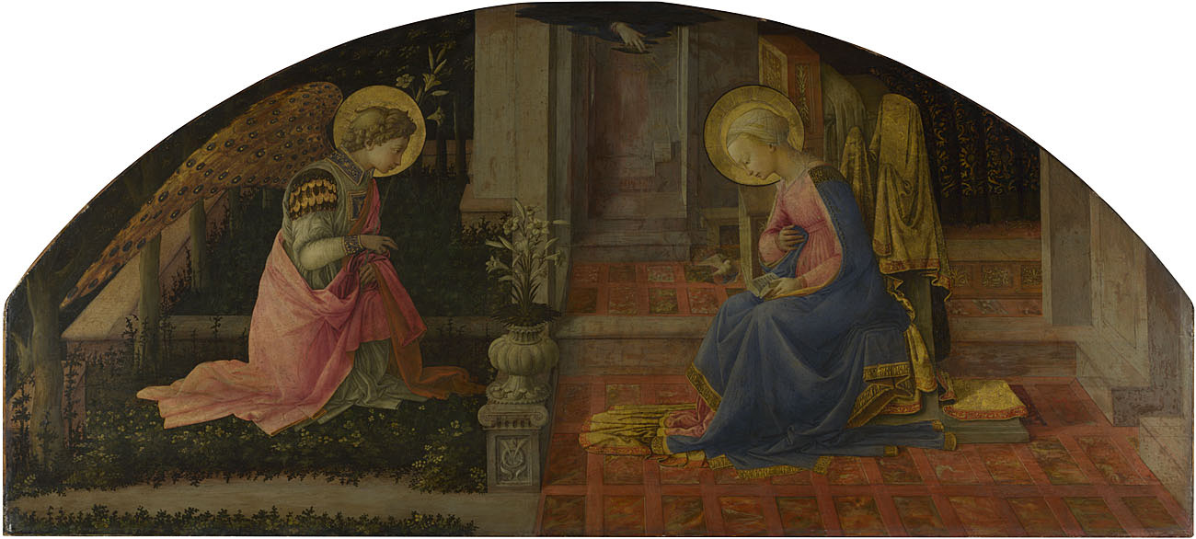
Fra Filippo Lippi, The Annunciation, about 1450-3 © The National Gallery, London.
Presented by Sir Charles Eastlake, 1861

